Slide 1
Exploring Areas in Haifa for Businesses
Clustering and Segmentation of Haifa’s Areas

Slide 2
01
Introduction
Agenda
02
Required Data
03
Methodology
04
Results

Slide 3
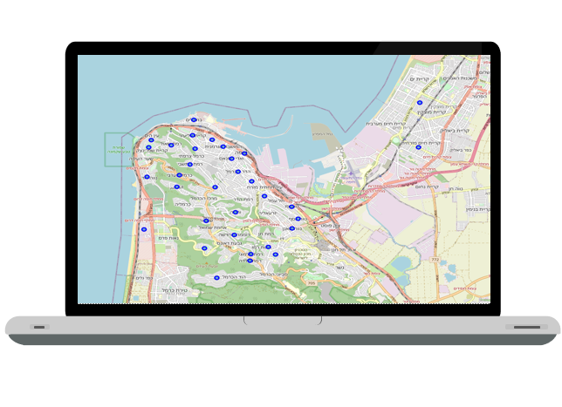
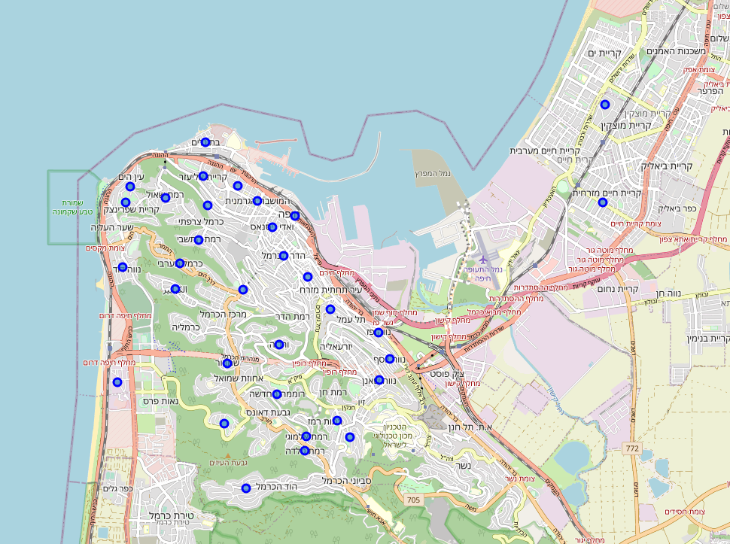
Introduction
A businessman wants to start a new business in Haifa and wants to know where he should locate it.
Haifa is a big city, and it is so diverse.
Good business location increase the probability to make it prosperous.

Slide 4


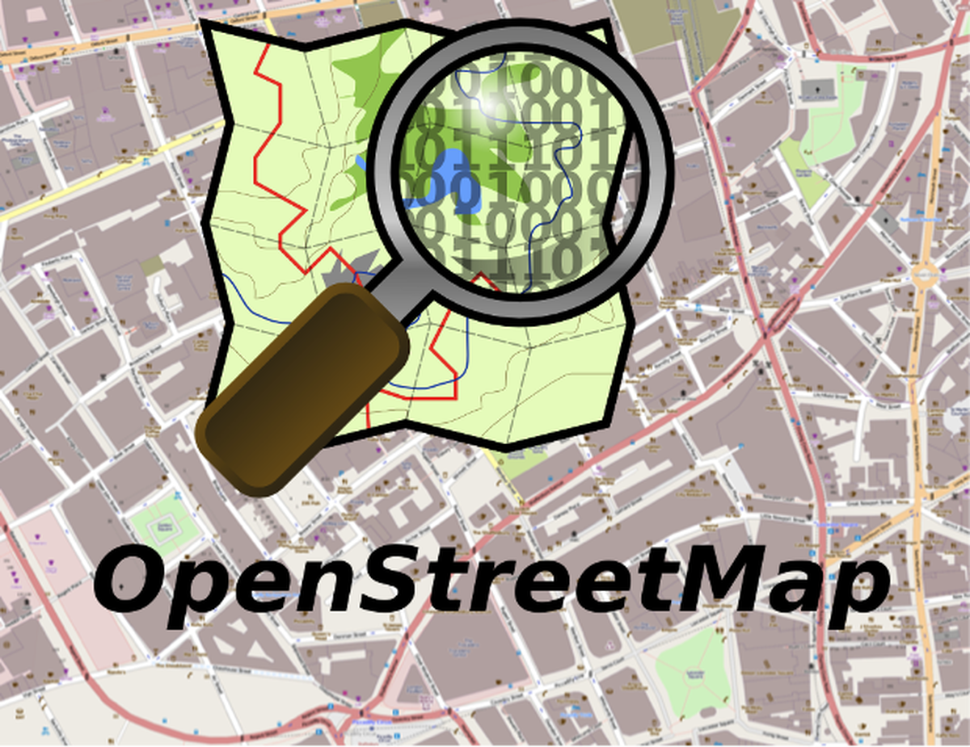
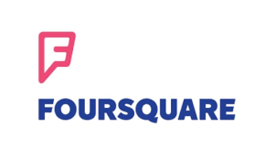
Required Data
Neighborhoods |  |  | Point of Interests (POI)
Name | Latitude | Longitude | POI name | POI Latitude | POI Longitude | Neighborhood
Neighborhoods
Point of Interests (POI)
The list of Haifa’s neighborhoods was taken from Wikipedia using BeautifulSoup python package.
The location data was taken with Geopy python package.
All the data was taken with OpenStreetMap and Foursquare APIs.

Slide 5
Methodology
Results
Machine Learning
In the next slide.
Data Preparation
Divide the neighborhoods to 2 disjoint union sets using KNN algorithm.
Data Cleaning
Encoding of categorial features with 1-hot vector encoding.
Creating a profile foreach neighborhood.
Data Scraping
Union of information from both geolocation sources.
Removal of duplicates.
Searching for the data shown in the previous slide.

Slide 6
Results and Observations
Results
In 81.25% of the neighborhoods, the classifier was right
I got false positive error in 12.5% of the neighborhoods.
In 1 case I got false negative error (6.25% of the cases)
The red marks indicate areas that we should start a new business. The others marked in purple.

Slide 7
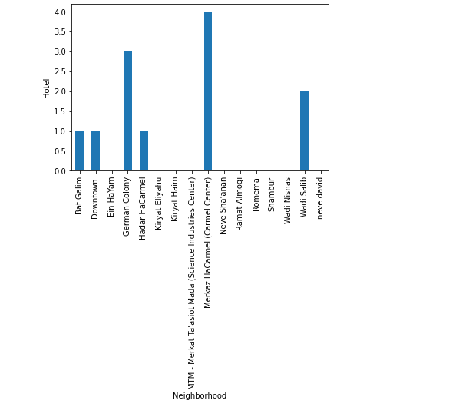
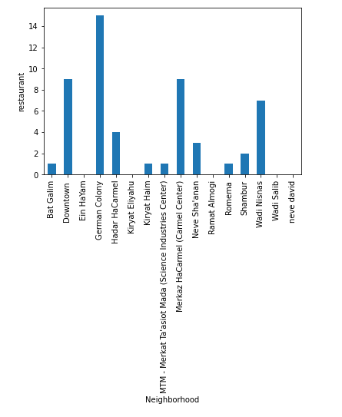
Results and Observations
Number of hotels per neighborhood
Number of restaurants per neighborhood

Slide 8
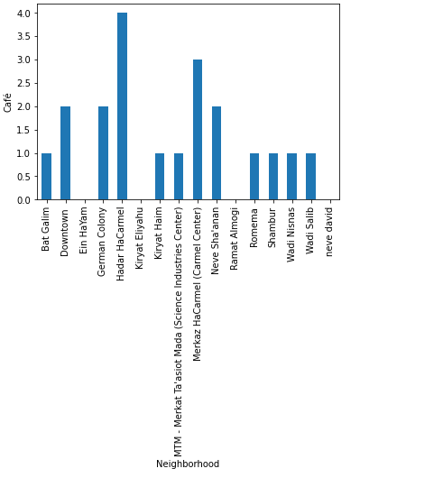
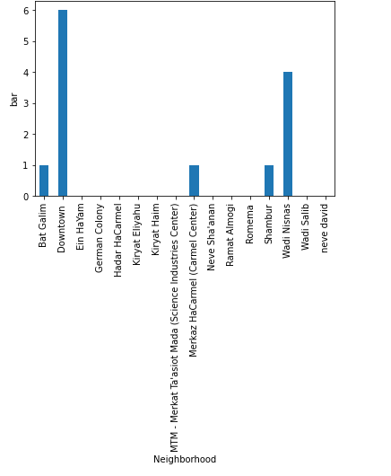
Results and Observations
Number of cafes per neighborhood
Number of bars per neighborhood

Slide 9
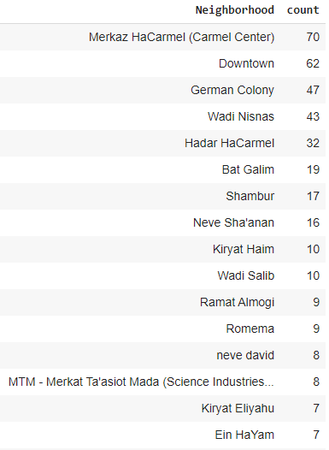
Results and Observations
Observations
Specific locations of the hotels.
Neighborhoods with big number of cafes, hotels, bars and restaurants are considered to the known areas of Haifa.
Neighborhoods with small number of POIs are considered the residential areas of Haifa.
The main observation: we should invest money for a business in the well-known areas of Haifa.
The upper median of the neighborhoods with the most points of interest.

Slide 10
THANK YOU

